Slide 1

Student Name:- Minidu Wickramaarachchi(杜满)
Student ID:- 202352620027
Supervisor Name:- Professor Luo Yuemei

Slide 2
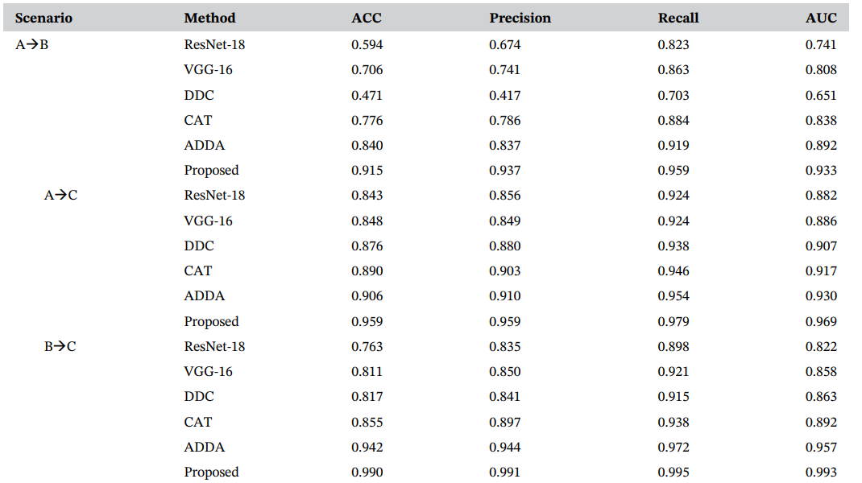
Result Comparison
Cross-domain retinopathy classification with optical coherence tomography images via a novel deep domain adaptation method
Original Results of the Paper

Slide 3
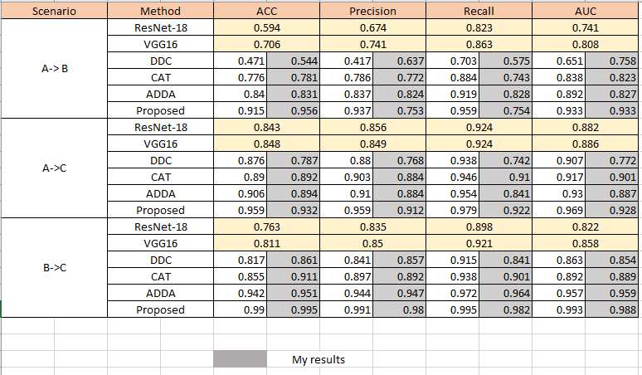
Results generated relate to the paper – own testing

Slide 4
Comparison Result Explain
The first table uses eight different methods (ResNet-18, VGG16, DDC, CAT, ADDA, Proposed, another ResNet-18, and another VGG16). The second table only uses four methods (ResNet-18, VGG16, ADDA, and the proposed method).
The proposed method in the second table outperforms all other methods across all three classification tasks (A->B, A->C, B->C) according to all four metrics.
In the first table also, the proposed method also outperforms all other methods in the A->B classification task according to all four metrics, but its performance is lower in the other two tasks.
Overall, there is a significant improvement in the performance on all three classification tasks.

Slide 5
Reason for some value differences
In the results of mine I found out that some values are bit off from the original when come to precision, recall and AUC. I found out that the method or the evaluation format is bit different.
Software and environment differences also a main reason for some differences.

Slide 6
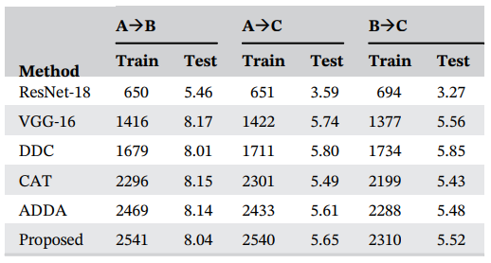
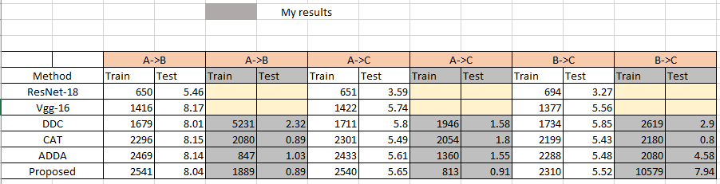
Training Time Comparison
Original Results of the Paper
Results of the Training

Slide 7
Reason for some value differences
In the training process some of the scenarios are run on top of each other, because of that when come to the accessibility of the model and hardware limitations some took long time to train.

